Slide 1
Late to Class!
Chun-Ting Liu Juan Piñeros

Slide 2

Have you ever been late to class?
A rush of adrenaline. A taste of danger. Twitches from your morning coffee. You’re not moving through the classrooms - the classrooms seem to move around you.

Slide 3
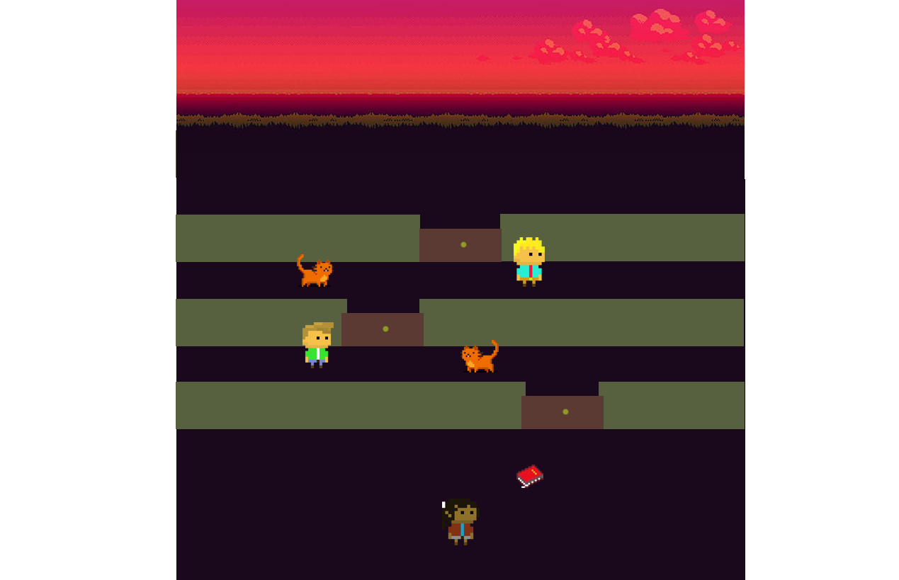
Someone filled the High Line with obstacles!
You’re not only late to class, but now you have to get around a maze of walls, sleepy students and campus cats. Your objective is to get to the classroom, find out who did this, and defeat them.
Try to keep yourself in the screen - the walls will try to push you off and the enemies will slow you down. Throw notebooks to break the doors blocking your way. Get to class fast, because attendance is 15% of the grade.

Slide 4
Main Character
You are this poor student who is late to class! You can walk in four directions by pressing WASD, click mouse to shoot a notebook, and press space to jump. Of course, you can only jump over the campus cat, not the wall.

Slide 5
Enemies
Campus cat Felis catus campusiensis
Sleepy student Homo sapiens tiredii
Enemies, when collided with, make you slower, meaning that you will reach the doors in more time and are more likely to be pushed down by the walls. They move along a horizontal axis and can be dealt with by shooting notebooks or jumping.

Slide 6
Game mechanics
The wall will keep moving down (or the screen move up), and there are closed doors generated at random location on the wall. If you don’t want to be pushed out of the screen, you have to shoot notebooks at the door to open it before you are able to pass the wall and move up.
You can also shoot notebooks to enemies to get rid of them.

Slide 7


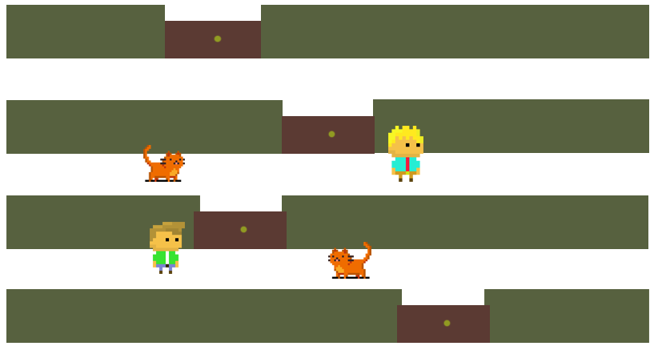
Objective
The objective of the game is to maintain the character in the screen - this is, making the character pass through the incoming walls fast enough so that the walls don’t push the character out of the screen.
Once a set number of walls is passed, a boss battle is started. If the player hits the boss enough times with notebooks, the boss will be defeated and the game will be over.
Kill Zone

Slide 8
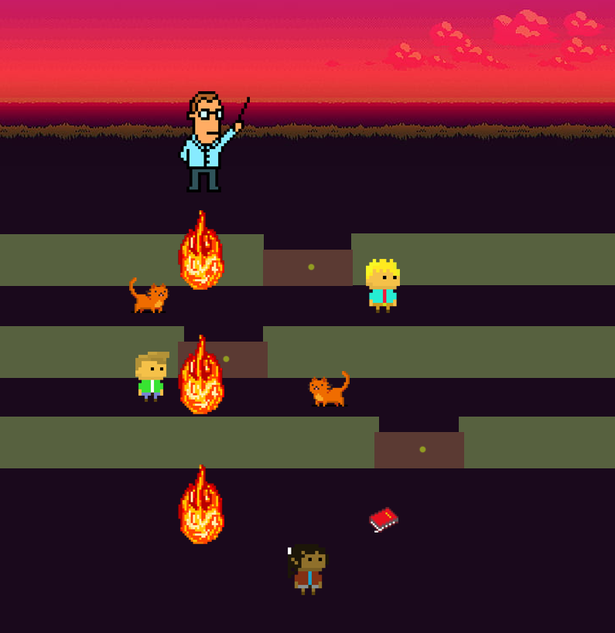
Final boss
When you pass a certain amount of wall, the final boss, aka the Professor, will appear at the top of the screen. He/she will keep throwing things at you ( question sheets, computers etc.), and you have to dodge them, or the wall will move faster. Once you throw enough notebooks at the Professor, you will win.

Slide 9


Controls and keys listened
W
A
D
Space
S
(jump)

Slide 10
Winning condition
After the Professor appears, and you manage to throw enough notebooks at him, you win the game, which means you successfully arrive at the classroom in time!

Slide 11
Losing condition
The effect of the walls descending into the player is achieved by moving the screen upwards. The character loses the game if it leaves the current display area.
Kill Zone

Slide 12
Releasing December 12th
can’t wait?
*hopefully.

